Slide 1



Bookshop
Group 8

Slide 2


Agenda
Database Overview
Tables: Books, Publishers, Authors & Genres
Tables cont..: Customers, Orders, Order Details & Employees
Core Requirements:
Using any type of the joins create a view that combines multiple tables in a logical way
In your database, create a stored function that can be applied to a query in your DB
Prepare an example query with a subquery to demonstrate how to extract data from your DB for analysis
Advanced Requirements:
In your database, create a stored procedure and demonstrate how it runs
Create a view that uses at least 3-4 base tables; prepare and demonstrate a query that uses the view to produce a logically arranged result set for analysis.
Prepare an example query with group by and having to demonstrate how to extract data from your DB for analysis
Questions!

Slide 3

Analysis – What are we trying to achieve?
Questions to Answer:
What are our total sales by country?
Who are the customers that belong to the country that sold the most?
What are our Total Sales to date?
How do we update the stock quantity?
What Genre’s are our Top Performing to date?
Out of all our Genre’s, which are underperforming where we sold less than or = to 10 QTY’s sold to date?
Views:
Sales by Country – View – Viewing total sales by country
Book Sales – View – Master Sales table of products sold (QTY’s & Price)
Stored Function/Stored Procedure:
Stored Function - Calculate Total Sales
Stored Procedure - Stock update in Database

Slide 4

Database overview

Slide 5

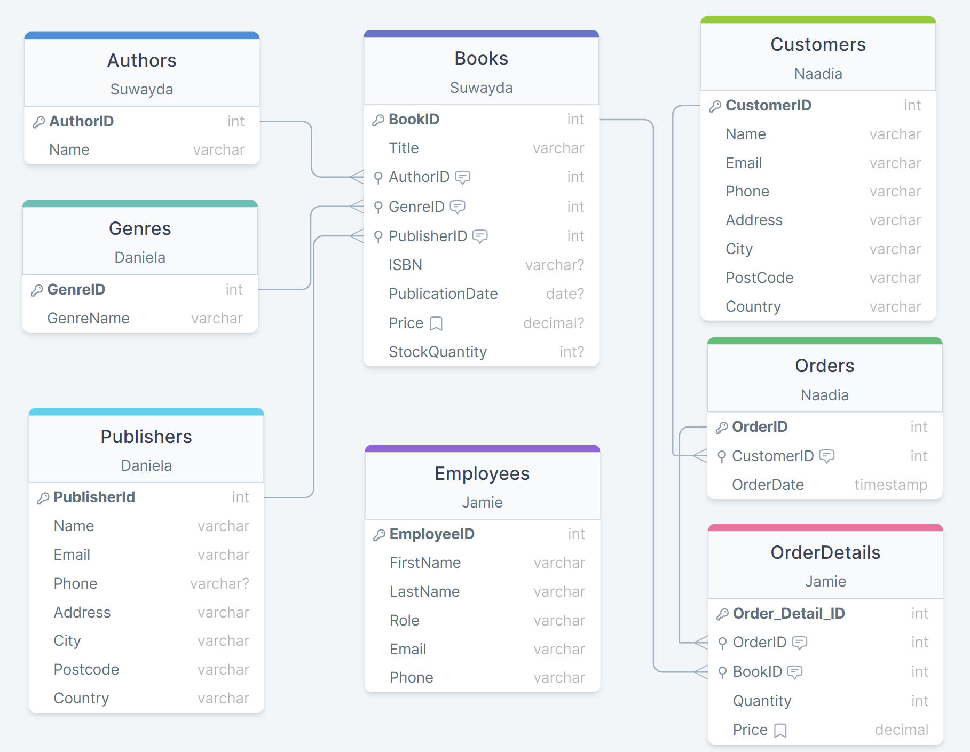
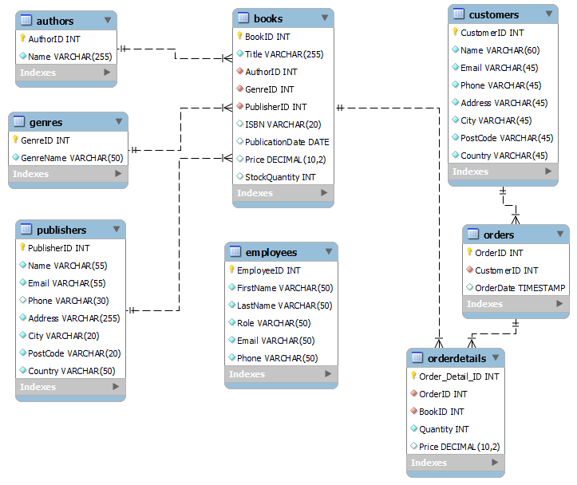
Database overview - Schema
Core Requirements:
Create relational DB of your choice with minimum 5 tables (8 for groups)
Set Primary and Foreign Key constraints to create relations between the tables
Create DB diagram where all table relations are shown
Notes:
Group 8 have decided to create a rational database on a bookshop. Examples of some key features which have been included in the database are tables, primary and foreign keys as well as store functions.

Slide 6
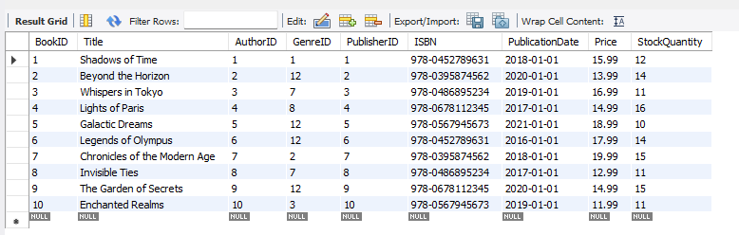
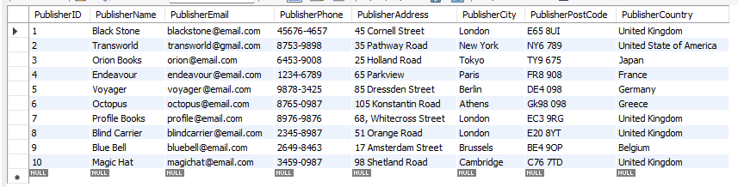
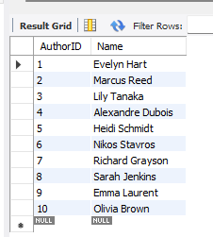
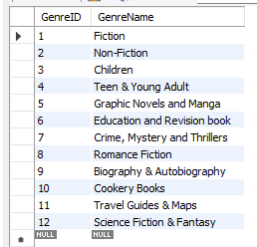
Schema - TABLES
Books
Publishers
Authors
Genres

Slide 7
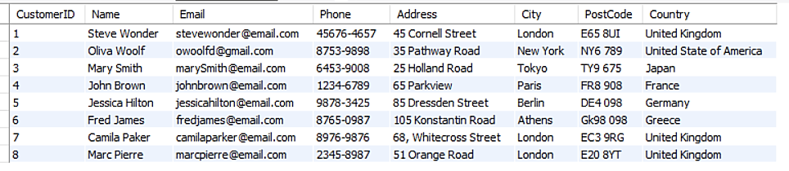
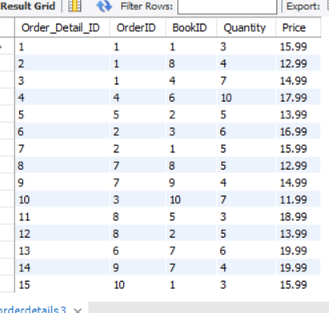
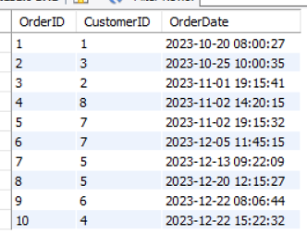
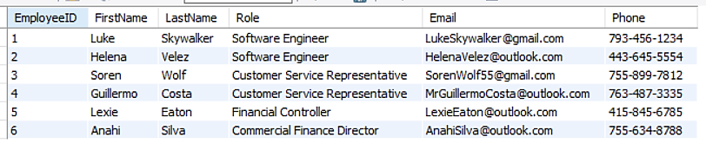
Schema – TABLES cont..
Customers
Orders
Order Details
Employees
Notes:
Employees - Table to be used for future -- Examples are checking Customer Service teams & how many customers queries they solved

Slide 8

Requirements
Answers to our questions

Slide 9
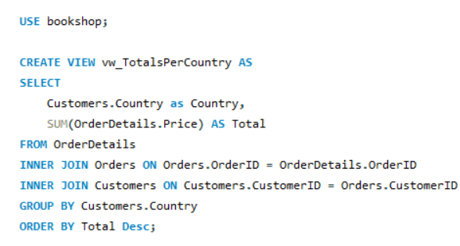
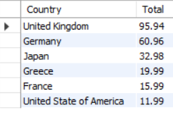
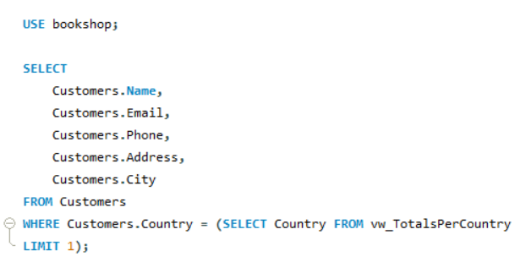
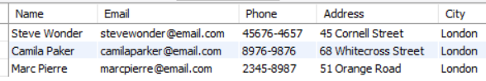
DANIELA
Total Sales per Country: Using TotalsPerCountry view to analyse total sales per Country in Descending order to see our top performing Countries.
Questions
How much is the total sale per country?
Using a view that joins the relevant tables and show the total sales.
Requirements
Who are the customers that belong to the country that sold the most?
Using query to list the customers linked to a subquery that uses the view (above) to find the list of customers from the country which sold the most.
Using any type of the joins create a view that combines multiple tables in a logical way.
Prepare an example query with a subquery to demonstrate how to extract data from your DB for analysis
List of customer using a subquery that uses the TotalsPerCountry view, showing customers details from the country which should the most.

Slide 10
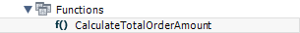
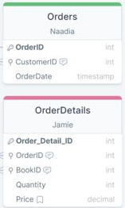
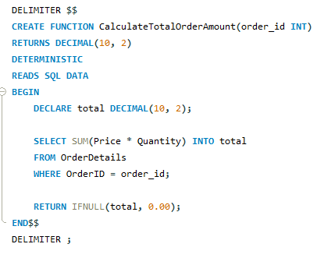

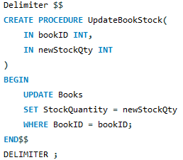
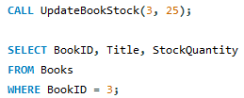
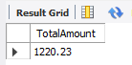
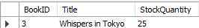
suwayda
Finding out the total order amount by calculating the sum of all the orders with the same OrderID in the OrderDetails table
Questions
Requirements
In your database, create a stored function that can be applied to a query in your DB
In your database, create a stored procedure and demonstrate how it runs
What is the total order amount?
How to update the stock quantity?
Using a stored procedure to update the stock quantity of a book.
Calling the function

Slide 11
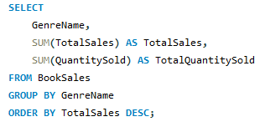
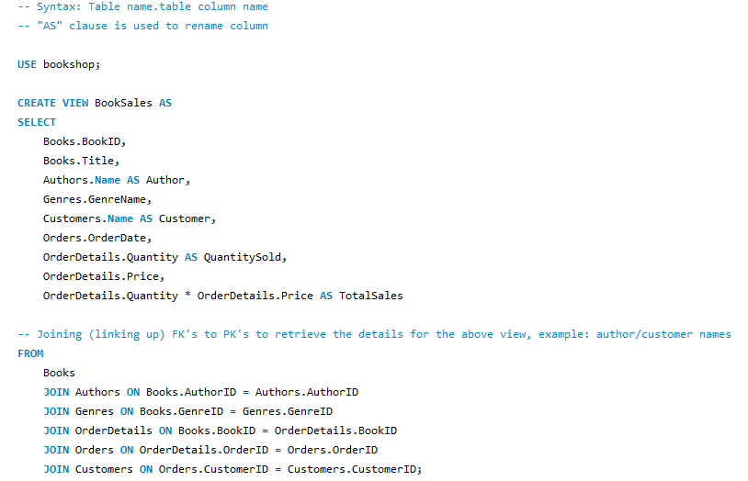
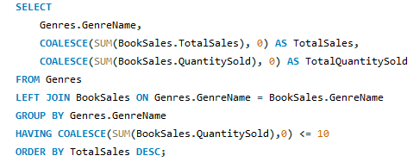
Jamie
Top Performing Genre’s: Using BookSales view to analyse total sales & QTY's by Genre in Descending order to see our top performing Genre's sold
Questions
What Genre’s are our Top Performing to date?
Requirements
1. Create a view that uses at least 3-4 base tables; prepare and demonstrate a query that uses the view to produce a logically arranged result set for analysis.
Out of all our Genre’s, which are underperforming where we sold less than or = to 10 QTY’s sold to date
2. Prepare an example query with group by and having to demonstrate how to extract data from your DB for analysis
Underperforming Genre’s: QTY’s sold less than or equal to 10
Stored view to create a Master Book Sales table using all tables in database except publishers & employees

Slide 12
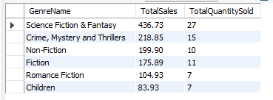
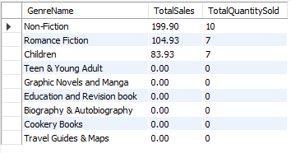
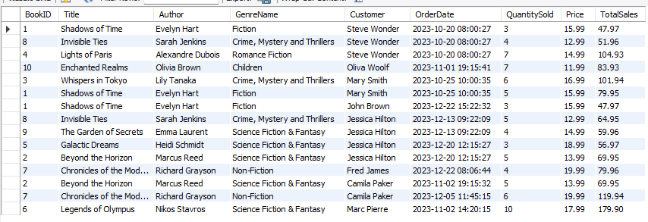
Jamie
Top Performing Genre’s
Questions
What Genre’s are our Top Performing to date?
Requirements
1. Create a view that uses at least 3-4 base tables; prepare and demonstrate a query that uses the view to produce a logically arranged result set for analysis.
Out of all our Genre’s, which are underperforming where we sold less than or = to 10 QTY’s sold to date
2. Prepare an example query with group by and having to demonstrate how to extract data from your DB for analysis
Underperforming Genre’s: QTY’s sold less than or equal to 10
Stored view to create a Master Book Sales table using all tables in database except publishers & employees

Slide 13
Thank you!
Any Questions?

Slide 14

Team
Suwayda Dirie
Jamie Love
Daniela Saraiva
Naadia Ajmal

